Slide 1
Objectives
In this session, you will learn to:
Understand access specifiers
Use static variables and functions
Use friend functions and classes

Slide 2
Access Specifiers
The object-oriented approach hides the unnecessary
details of a program and shows only the essential
characteristics of the program to the user. This
process is known as abstraction.

Slide 3
Abstraction and Encapsulation
Encapsulation is defined as the process of enclosing
one or more items within a physical or logical
package. It involves preventing access to
nonessential details.
Encapsulation is also called information hiding or
data hiding, since it involves hiding many of the
important details of an object from the user.
Abstraction enables you to make the relevant
information visible.
Encapsulation assists abstraction by providing a
means of suppressing the nonessential details.

Slide 4
Implementing Abstraction and Encapsulation using Access Specifiers
Public access specifier:
  Allows a class to expose its member variables and member functions to other functions and objects.
  Example:
  #include<iostream>
  class Car
  {
  public:
  char color[21];
  };

Slide 5
Implementing Abstraction and Encapsulation using Access Specifiers (Contd.)
int main()
{
Car ford;
/* The . operator is used to access member data and functions */
cin >> ford.color; /*Since the color variable is public, it can be accessed outside the class definition.*/
return 0;
}

Slide 6
Implementing Abstraction and Encapsulation using Access Specifiers (Contd.)
Private access specifier:
  Allows a class to hide its member variables and member functions from other class objects and functions.
  Offers data hiding by protecting data from external alteration.

Slide 7
Implementing Abstraction and Encapsulation using Access Specifiers (Contd.)
Protected access specifier:
  Allows a class to hide its member variables and member functions from other class objects and functions just like private access specifier.
  Is used while implementing inheritance.

Slide 8
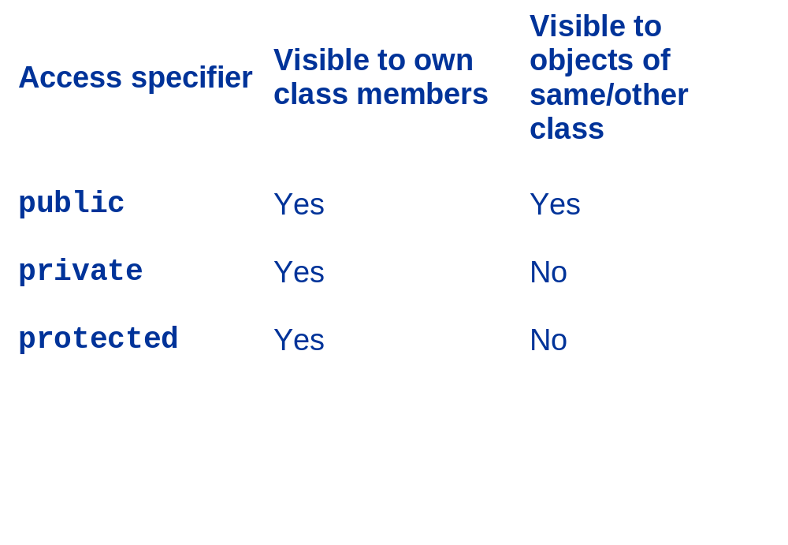
Implementing Abstraction and Encapsulation using Access Specifiers (Contd.)

Slide 9
Static Variables
Retain their values even after the function to which
they belong has been executed.
Example:
class staticExample
  {
  int data;
  static int staticVar; // static //variable declared
  public:
  //Definition of member function
  };

Slide 10
Static Functions
Can only access static variables
Are accessed using class names

Slide 11
Friend Functions
  In order to access the non-public members of a class,
  C++ provides the friend keyword.
  Any non-member function may be declared a friend
  by a class, in which case the function may directly
  access the private member attributes and methods of
  the class objects.
  The friend functions are used when the design of a
  class requires that another class or non member
  function should access the private elements of the
  class.

Slide 12
  Friend Classes
  Just as a function can be made a friend of a class, a
  class can also be made a friend of another class.
  Example:
    class distance
    {...
    friend class length;
    ...
    };

Slide 13
Summary
In this session, you learned that:
Abstraction denotes the essential characteristics of an object that distinguishes it from all other kinds of objects and thus provides crisply defined conceptual boundaries, relative to the perspective of the viewer.
Encapsulation is the process of hiding all of the
details of an object that do not contribute to its
essential characteristics.
An access specifier is used to determine whether any other class or function can access the member variables and functions of a particular class.

Slide 14
Summary (Contd.)
C++ supports three access specifiers:
  public
  private
  protected
The public access specifier allows a class to
subject its member variables and member functions to other functions and objects.
The private access specifier allows a class to hide its member variables and member functions from
other class objects and functions.

Slide 15
Summary (Contd.)
The protected access specifier allows a class to hide its member variables and member functions
from other class objects and functions just like
private access specifier is used while
implementing inheritance.
The static variable retains its value even after the function to which it belongs has been executed.
Static functions can only access static variables; non-static variables cannot be accessed using static functions.

Slide 16
Summary (Contd.)
Any non-member function may be declared a friend
by a class, in which case the function may directly
access the private member attributes and methods
of the class objects.
A class can also be made a friend of another class.

